Slide 1
Chapter 7 Lists and Tuples
Jing Cheng
QQ: 42546062

Slide 2
Outline
What is a List
What you already know how to do with list
Lists are different than Strings
Old and New Friends: split and other functions and methods
Working with some examples
Mutable Objects and References
Tuples
8. Lists: The Data Structure
9. Algorithm Example
10. Python Diversion：List Comprehension
11. Visual Vignette: More Plotting

Slide 3
7.1 What is a List

Slide 4
What is a list？
Python‘s built-in list type is also a collection type.
Like STRINGS, lists are a sequence type and are an iterable type.
Built-in type?
Collection type?
Sequence type?
iterable type?

Slide 5
Collection Type
Integer
Boolean
Floating-point
Strings
Built-in type?
Tuple
Sequence Type
List
Collection Type
Set
Unordered Collection
Dictionary

Slide 6
Sequence Type
Sequence Type is an ordered collection type.
A sequence type is one that supports the membership operator (in), the size function (len()), slices ([]), and is iterable.
Python provides five built-in sequence types: bytearray, bytes, list, str, and tuple.
set type and dict type is unordered collection type, which supports the membership operator (in) and the size function (len()), and is iterable.

Slide 7
The characteristics of list
It is a collection type.
It is a sequence type.
It is a iterable type.
It is mutable.
It can contain any type elements.

Slide 8
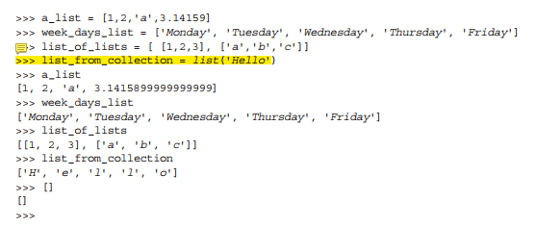
Constructing a list
Lists can be created with the square brackets ([ ]).
Different types can be in the same list.
Any Python type can be a list element, such as a list, or a tuple, etc.
empty list
How to use the constructor of list?
This constructor takes a single argument and that argument must be an iterable.
Non-iterable types (integers, floats, Booleans, etc.) cannot be used as an argument to the list constructor.

Slide 9
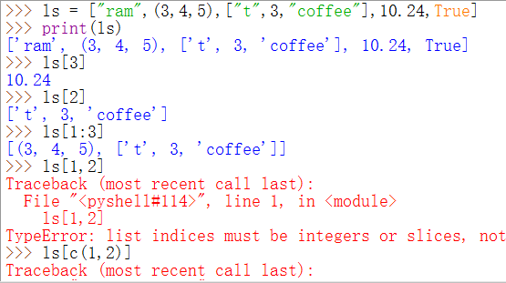
How to get elements of a list?
The different usage of square brackets ([ ])
The index operator
To construct to list

Slide 10
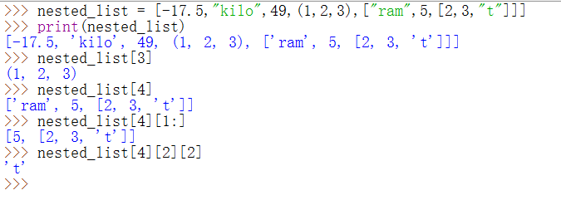
A nested list
A nested list is also known as a list of lists.

Slide 11
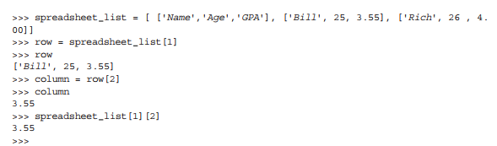
2-D data sets
Name | age | GPA
Bill | 25 | 3.55
Rich | 26 | 4.00

Slide 12
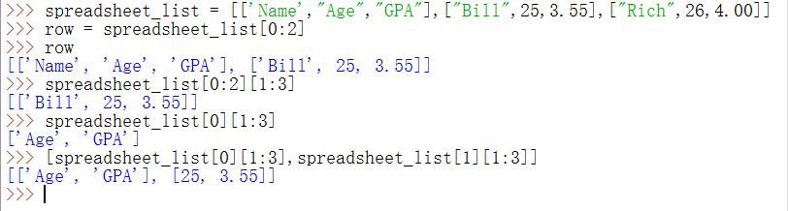
Name | age | GPA
Bill | 25 | 3.55
Rich | 26 | 4.00

Slide 13
例子
csv.reader的例子

Slide 14
7.2 Operating of lists

Slide 15
Similarities with strings
indexing (the [ ] operator) and slicing ([:])
concatenate/+ (but only of lists)
repeat/*
membership (the in operator)
len (the length operator)
compare
与字符串的相同之处

Slide 16
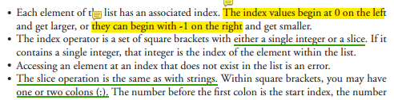

Indexing and Slicing

Slide 17
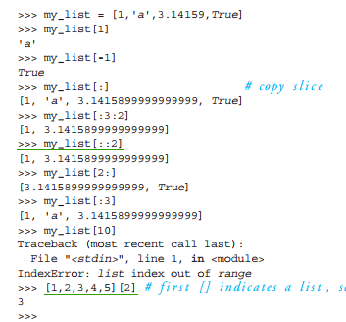

Slide 18
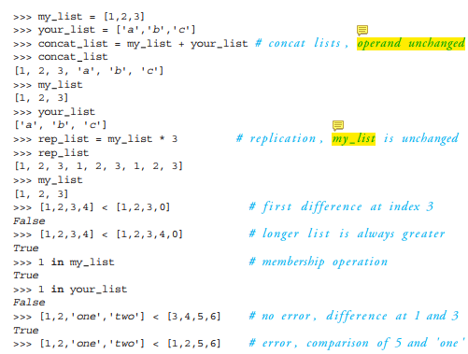

Operators
+, *, in, comparison( <, >, <=, >=, = =, != )
+的两侧的操作数类型必须一致，都是list
*的两侧，一个是list，一个必须是整数
这些运算符都不会改变操作数。

Slide 19
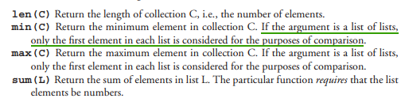
Functions

Slide 20

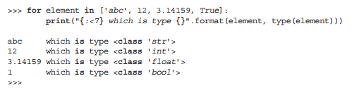
List Iteration

Slide 21
7.3 Lists are different than Strings

Slide 22
Same with Strings
Sequence
slicing and indexing
in/not in operators
len() function
iterable(可迭代的）
+ and *
compare

Slide 23
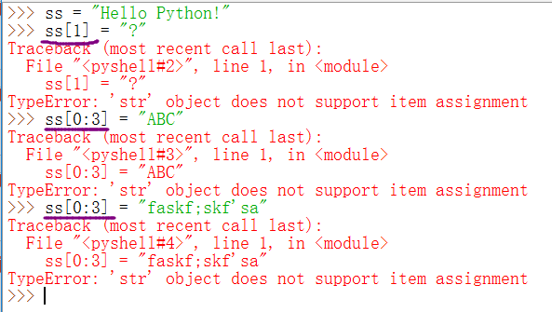
Difference with Strings
Lists Are Mutable / Strings are immutable

Slide 24
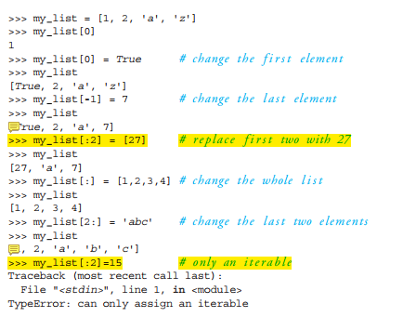
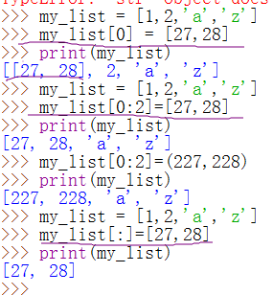
1. Index assignment
2. slice assignment
(The only caveat is that the values being assigned must be a collection.)

Slide 25
List Methods Function
Non-modifying methods
Methods that Modify the List

Slide 26
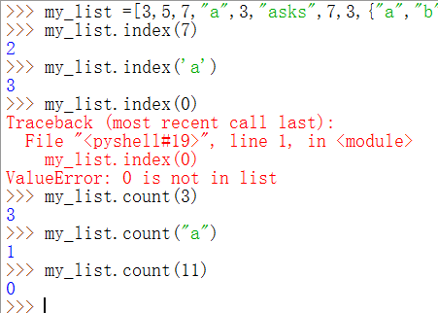
Non-modifying methods
index(x)
count(x)

Slide 27
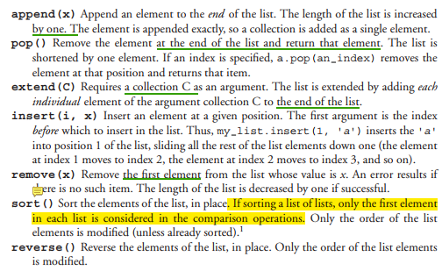
Methods that Modify the List

Slide 28
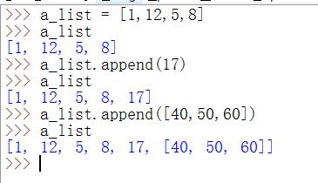
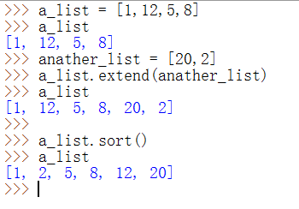

Slide 29
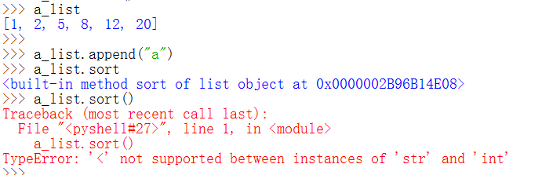
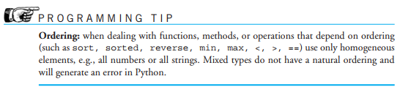

Slide 30
More about list methods
most of these methods do not return a value
This is because lists are mutable, so the methods modify the list directly. No need to return anything.
Can be confusing
大多数列表操作不返回值！

Slide 31
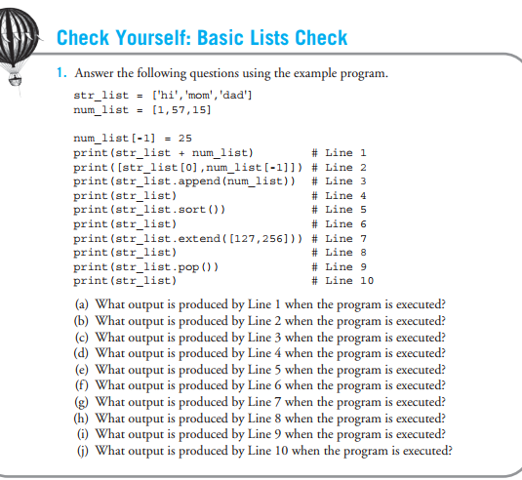

Slide 32
练习
输入：一组学生考试成绩，以#结束
功能：统计0-9，10-19,20-29，…,90-99,100。各个分数段的人数
输出：打印出各个分数段人数

Slide 33
7.4 Split and other functions and methods

Slide 34
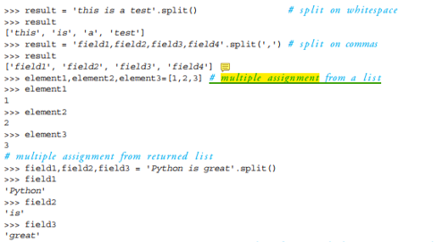
Split and Multiple Assignment
strings.split(delim=“×”) ➔ a list
multiple assignment

Slide 35
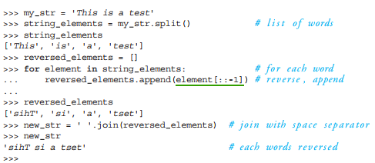
Using join
str.split() : take a string to a list
str.join(): take a string list (as argument) to a new string, and the calling string is used as a delimiter.

Slide 36
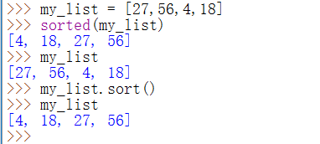
The sorted Function
Difference between sort() method and storted() function
The sort method works only with lists. → list.sort()
The sorted function (not a method, a function) will sort any collection.
The argument provided to sorted is not modified by the action of the function.

Slide 37
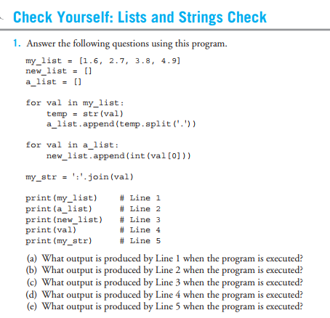

Slide 38
7.5 Working with some examples other functions and methods

Slide 39
Example: File Analysis( p305)
下载“葛底斯堡演讲”==》“gettysburg.txt ”
对该“gettysburg.txt”文件进行分析：
Determine a file’s length, in words.
Count the number of unique words in the file.

Slide 40
Strategy ( Algorithm )
Open the file for reading.
Get rid of the punctuation in the file.
Initialize the speech list to be empty.
For each line in the file:
Extract words from the line into a list (split).
Add that list of words onto the speech list (extend).
Find the length of the speech list

Slide 41
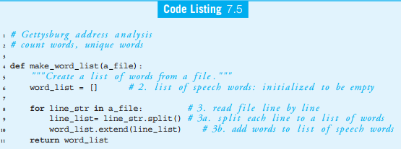

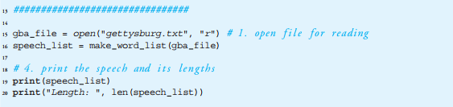

1）怎样去除“- -”？
2）怎样去除标点符号？

Slide 42
Unique Words in the Gettysburg Address
Strategy( Algorithm):
1. Initialize our unique list to empty.
2. For each word in the argument list:
(a) If a word is not already in the unique list,
(b) Append the word to the unique list.

Slide 43
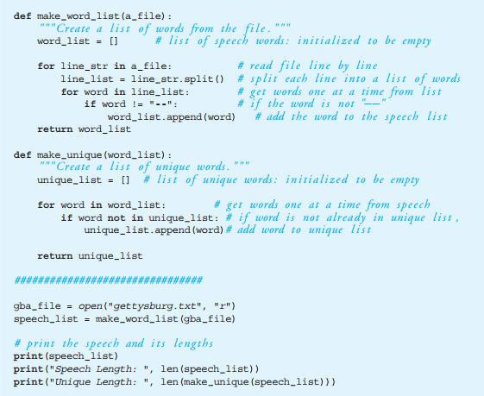

Slide 44
Better Idea of Unique
Problem of the above code：
A word should not be unique if it exists in the provided word list with different types of capitalization, e.g., we and We.
A word should not be unique if it exists In the provided word list with different surrounding punctuation, e.g., here., here,, and here.

Slide 45
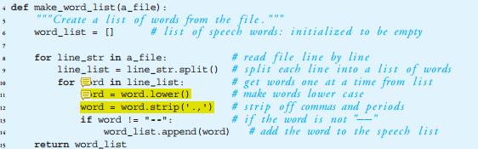
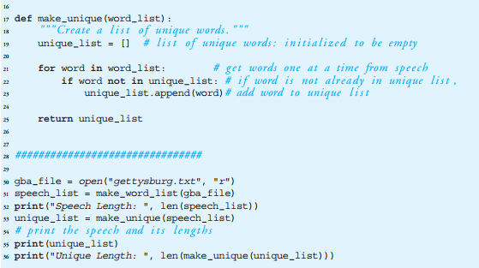

Slide 46
7.7 Tuples

Slide 47

The Definition of Tuple
It is a collection type.
It is a sequence type.
It is immutable.
It can contain any type elements.

Slide 48
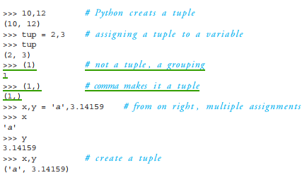
Creating a tuple
my_tuple = ( 1, 2, 3 )
① The comma, not the parentheses, is the operator that creates the tuple.
② To create a single-element tuple, one cannot create it with the expression (1), which simply yields 1 in the interpreter. The expression (1,) does create a single-element tuple.
逗号是创建元组的关键

Slide 49
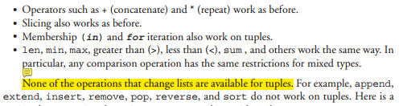
The Operations
The operations familiar from other sequences (lists and strings) are available, except, those operators that violate immutability.

Slide 50
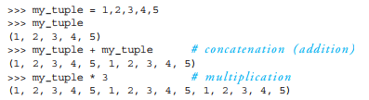
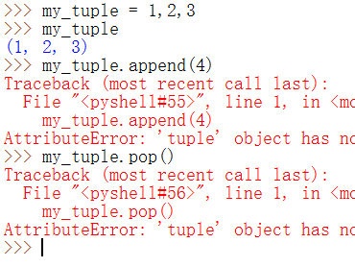
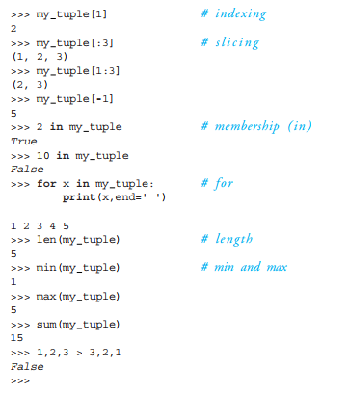

Slide 51
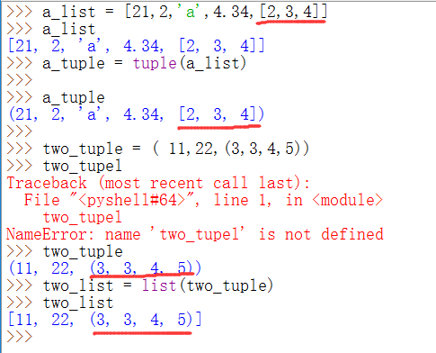

Getting Tuples from Lists，and vice versa

Slide 52

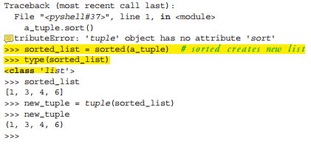
sort() method vs. sorted() function
sort() method
sort() function

Slide 53
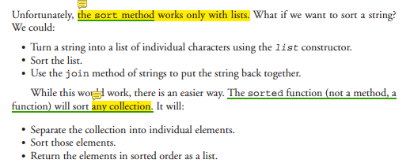
回顾：the sorted() function?

Slide 54
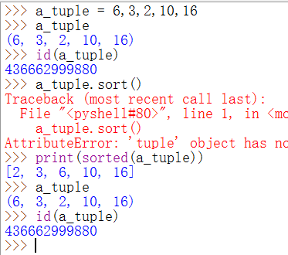

Slide 55
Why Tuples？
When we have the mutable list，why dose we need the immutable list——tuple？
The reason is that an immutable list provides a data structure with some integrity and some persistence. It is not possible to accidentally change a tuple.(元组不会被意外地改变）
Also, because tuples are immutable, they can be used in a few places where mutable object are not allowed.（比如，后续将介绍的字典的键）

